Slide 1
Protocols and Architecture
OSI & TCP/IP

Slide 2
Need For Protocol Architecture
File transfer
  Source must activate communication path or inform network of destination
  Source must check destination is prepared to receive or not
  File transfer application on source must check destination file management system will accept and store file for his user
  May need file format translation
Task broken into subtasks
Implemented separately in layers in stack
Functions needed in both systems
Peer layers communicate

Slide 3
Key Elements of a Protocol
Syntax
  Data formats
  Signal levels
Semantics
  Control information
  Error handling
Timing
  Speed matching
  Sequencing

Slide 4
Protocol Architecture
Task of communication broken up into modules
For example file transfer could use three modules
  File transfer application
  Communication service module
  Network access module

Slide 5
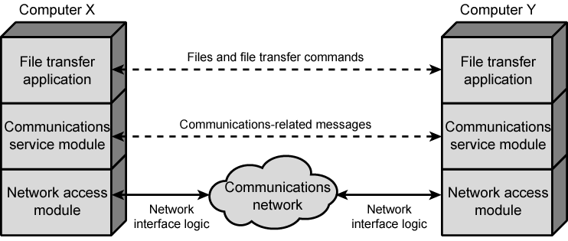
Simplified File Transfer Architecture

Slide 6
A Three Layer Model
Network Access Layer
Transport Layer
Application Layer

Slide 7
Network Access Layer
Exchange of data between the computer and the network
Sending computer provides address of destination
May invoke levels of service
Dependent on type of network used (LAN, packet switched etc.)

Slide 8
Transport Layer
Reliable data exchange
Independent of network being used
Independent of application

Slide 9
Application Layer
Support for different user applications
e.g. e-mail, file transfer

Slide 10
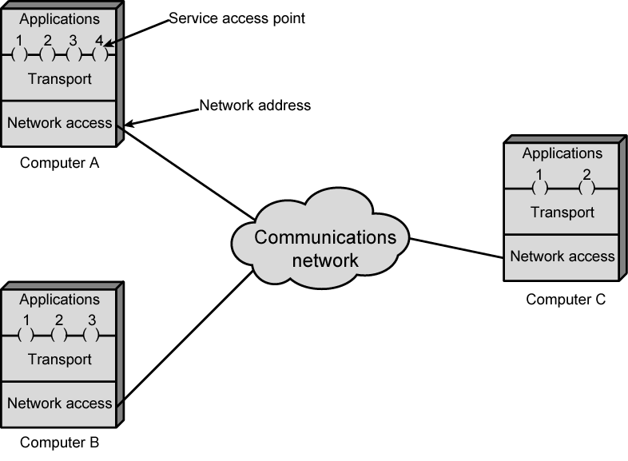
Protocol Architectures and Networks

Slide 11
Addressing Requirements
Two levels of addressing required
Each computer needs unique network address
Each application on a (multi-tasking) computer needs a unique address within the computer
  The service access point or SAP
  The port on TCP/IP stacks

Slide 12
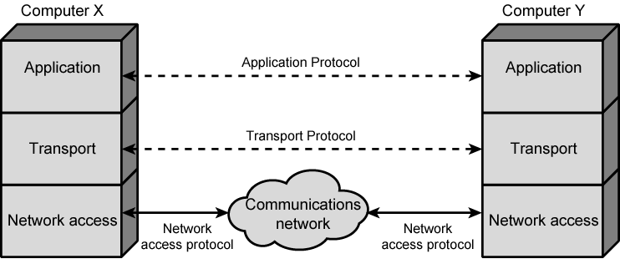
Protocols in Simplified Architecture

Slide 13
Protocol Data Units (PDU)
At each layer, protocols are used to communicate
Control information is added to user data at each layer
Transport layer may fragment user data
Each fragment has a transport header added
  Destination SAP
  Sequence number
  Error detection code
This gives a transport protocol data unit

Slide 14
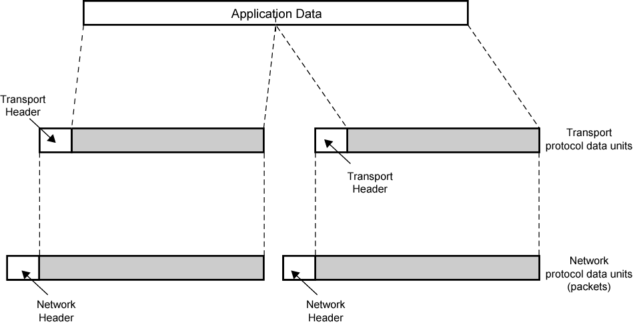
Protocol Data Units

Slide 15
Network PDU
Adds network header
  network address for destination computer
  Facilities requests

Slide 16
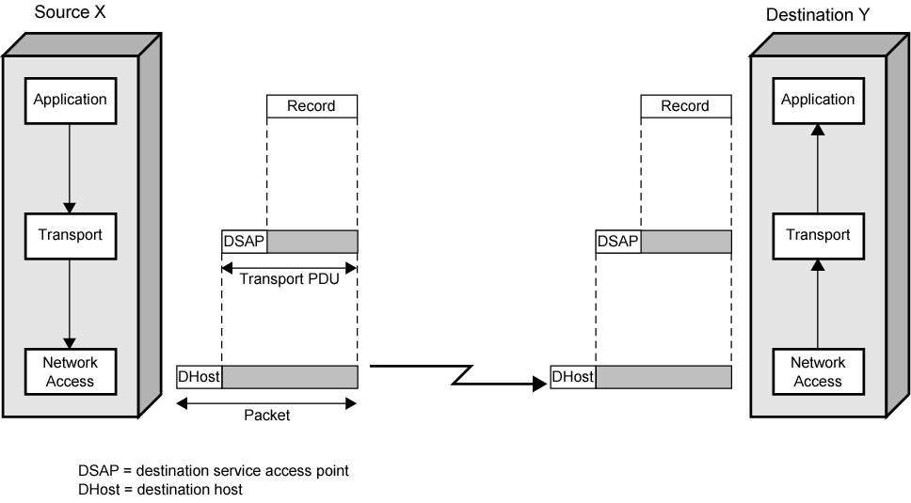
Operation of a Protocol Architecture

Slide 17
Standardized Protocol Architectures
Required for devices to communicate
Vendors have more marketable products
Customers can insist on standards based equipment
Two standards:
  OSI Reference model
    Never lived up to early promises
  TCP/IP protocol suite
    Most widely used
Also: IBM Systems Network Architecture (SNA)

Slide 18
OSI
Open Systems Interconnection
Developed by the International Organization for Standardization (ISO)
Seven layers
A theoretical system

Slide 19
OSI - The Model
A layer model
Each layer performs a subset of the required communication functions
Each layer relies on the next lower layer to perform more primitive functions
Each layer provides services to the next higher layer
Changes in one layer should not require changes in other layers

Slide 20
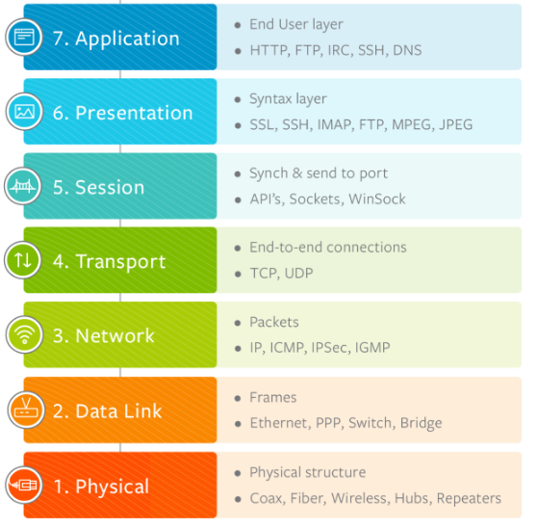
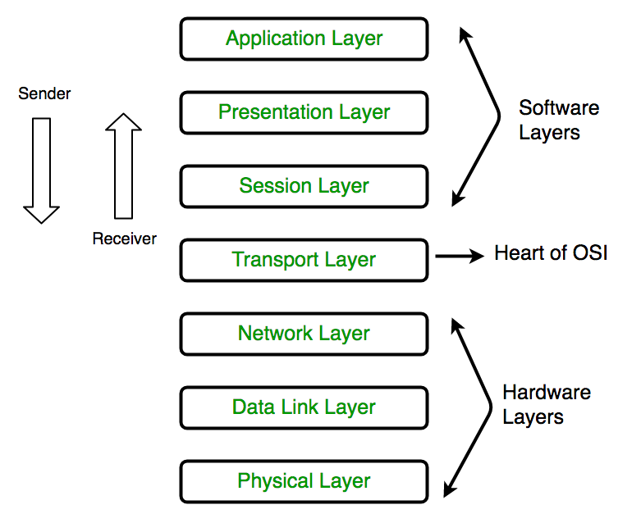
OSI Layers

Slide 21
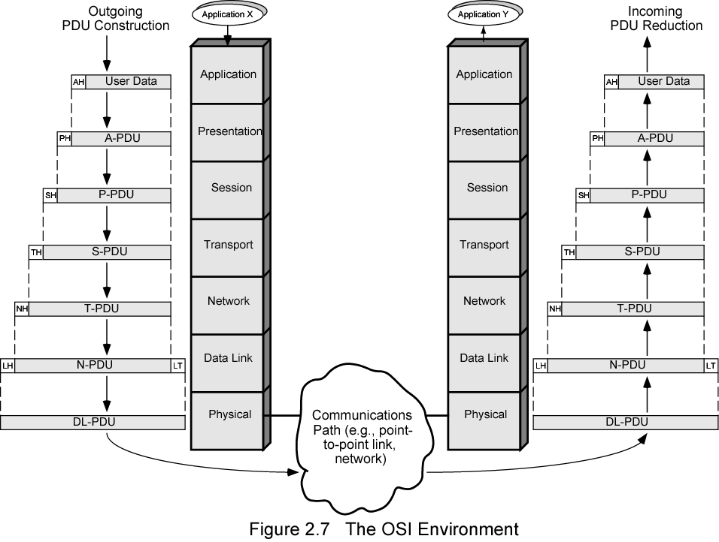
The OSI Environment

Slide 22
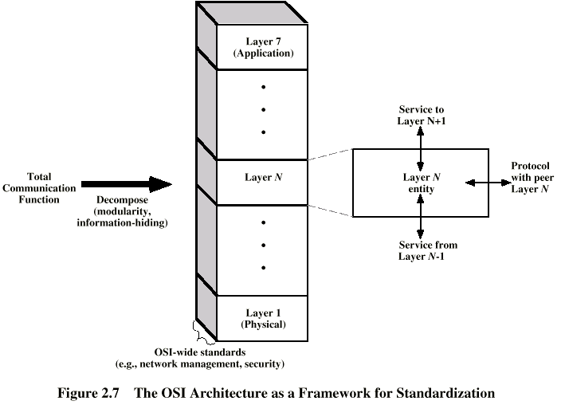
OSI as Framework for Standardization

Slide 23
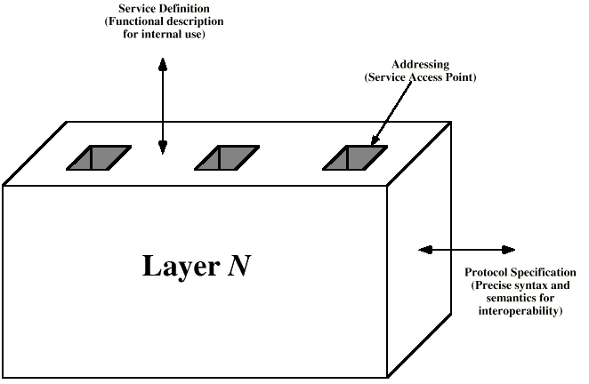
Layer Specific Standards

Slide 24
Elements of Standardization
Protocol specification
  Operates between the same layer on two systems
  May involve different operating system
  Protocol specification must be precise
    Format of data units
    Semantics of all fields
    allowable sequence of PCUs
Service definition
  Functional description of what is provided
Addressing
  Referenced by SAPs

Slide 25
Service Primitives and Parameters
Services between adjacent layers expressed in terms of primitives and parameters
Primitives specify function to be performed
Parameters pass data and control info

Slide 26
Primitive Types
REQUEST | A primitive issued by a service user to invoke some service and to pass the parameters needed to specify fully the requested service
INDICATION | A primitive issued by a service provider either to: indicate that a procedure has been invoked by the peer service user on the connection and to provide the associated parameters, or notify the service user of a provider-initiated action
RESPONSE | A primitive issued by a service user to acknowledge or complete some procedure previously invoked by an indication to that user
CONFIRM | A primitive issued by a service provider to acknowledge or complete some procedure previously invoked by a request by the service user

Slide 27
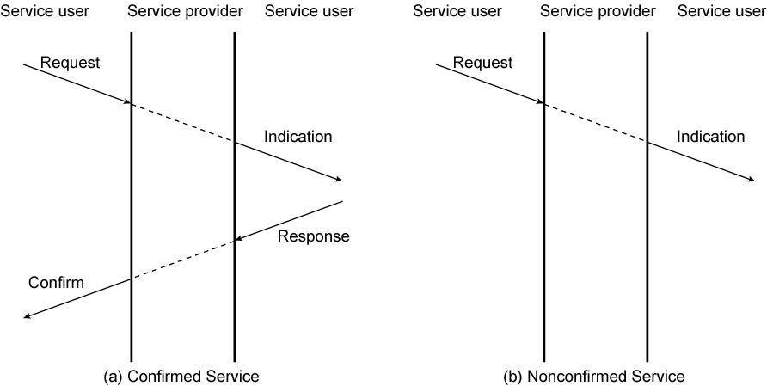
Timing Sequence for Service Primitives

Slide 28
OSI Layers (1)
Physical
The lowest layer of the OSI model is concerned with data communication in the form of electrical, optic, or electromagnetic signals physically transmitting information between networking devices and infrastructure. The physical layer is responsible for the communication of unstructured raw data streams over a physical medium. It defines a range of aspects, including:
  Electrical, mechanical, and physical systems and networking devices that include specifications such as cable size, signal frequency, voltages, etc.
  Topologies such as Bus, Star, Ring, and Mesh
  Communication modes such as Simplex, Half Duplex, and Full Duplex
  Data transmission performance, such as Bit Rate and Bit Synchronization
  Modulation, switching, and interfacing with the physical transmission medium
  Common protocols including Wi-Fi, Ethernet, and others
  Hardware including networking devices, antennas, cables, modem, and intermediate devices such as repeaters and hubs

Slide 29
OSI Layers (2)
Data Link
The second layer of the OSI model concerns data transmission between the nodes within a network and manages the connections between physically connected devices such as switches. The raw data received from the physical layer is synchronized and packaged into data frames that contain the necessary protocols to route information between appropriate nodes. The data link layer is further divided into two sublayers:
  The Logical Link Control (LLC) sublayer is responsible for flow controls and error controls that ensure error-free and accurate data transmission between the network nodes.
  The Media Access Control (MAC) sublayer is responsible for managing access and permissions to transmit data between the network nodes. The data is transmitted sequentially and the layer expects acknowledgement for the encapsulated raw data sent between the nodes.

Slide 30
OSI Layers (3)
Network
The third layer of the OSI model organizes and transmits data between multiple networks.
The network layer is responsible for routing the data via the best physical path based on a range of factors including network characteristics, best available path, traffic controls, congestion of data packets, and priority of service, among others. The network layer implements logical addressing for data packets to distinguish between the source and destination networks.
Other functions include encapsulation and fragmentation, congestion controls, and error handling. The outgoing data is divided into packets and incoming data is reassembled into information that is consumable at a higher application level. Network layer hardware includes routes, bridge routers, 3-layer switches, and protocols such as Internet (IPv4) Protocol version 4 and Internet Protocol version 6 (IPv6).

Slide 31
OSI Layers (4)
Transport
The fourth layer of the OSI model ensures complete and reliable delivery of data packets.
The transport layer provides mechanisms such as error control, flow control, and congestion control to keep track of the data packets, check for errors and duplication, and resend the information that fails delivery. It involves the service-point addressing function to ensure that the packet is sent in response to a specific process (via a port address).
Packet Segmentation and reassembly ensure that the data is divided and sequentially sent to the destination where it is rechecked for integrity and accuracy based on the receiving sequence.
Common protocols include the Transmission Control Protocol (TCP) for connection-oriented data transmission and User Datagram Protocol (UDP) for connectionless data transmission.

Slide 32
OSI Layers (5)
Session
As the first of three layers that deal with the software level, the session layer manages sessions between servers to coordinate communication. Session refers to any interactive data exchange between two entities within a network. Common examples include HTTPS sessions that allow Internet users to visit and browse websites for a specific time period. The Session Layer is responsible for a range of functions including opening, closing, and re-establishing session activities, authentication and authorization of communication between specific apps and servers, identifying full-duplex or half-duplex operations, and synchronizing data streams.
Common Session Layer protocols include:
  Remote procedure call protocol (RPC)
  Point-to-Point Tunneling Protocol (PPTP)
  Session Control Protocol (SCP)
  Session Description Protocol (SDP)

Slide 33
OSI Layers (6)
Presentation
The sixth layer of the OSI model converts data formats between applications and the networks. Responsibilities of the presentation layer include:
  Data conversion
  Character code translation
  Data compression
  Encryption and decryption
The presentation layer, also called the syntax layer, maps the semantics and syntax of the data such that the received information is consumable for every distinct network entity. For example, the data we transfer from our encryption-based communication app is formatted and encrypted at this layer before it is sent across the network.
At the receiving end, the data is decrypted and formatted into text or media information as originally intended. The presentation layer also serializes complex information into transportable formats. The data streams are then deserialized and reassembled into original object format at the destination.

Slide 34
OSI Layers (7)
Application
The application layer concerns the networking processes at the application level. This layer interacts directly with end-users to provide support for email, network data sharing, file transfers, and directory services, among other distributed information services. The upper most layer of the OSI model identifies networking entities to facilitate networking requests by end-user requests, determines resource availability, synchronizes communication, and manages application-specific networking requirements. The application layer also identifies constraints at the application level such as those associated with authentication, privacy, quality of service, networking devices, and data syntax.
Common application layer protocols include:
  File Transfer Protocol (FTP)
  Simple Mail Transfer Protocol (SMTP)
  Domain Name System (DNS)

Slide 35
Advantages of OSI Model
The OSI model helps users and operators of computer networks:
Determine the required hardware and software to build their network.
Understand and communicate the process followed by components communicating across a network.
Perform troubleshooting, by identifying which network layer is causing an issue and focusing efforts on that layer.

Slide 36
TCP/IP Protocol Architecture
TCP/IP protocol stands for the Transmission Control Protocol/ Internet Protocol. It was developed by the United States Department of Defence in the 1960s. It is a conceptual model that has a set of communication protocols used for the transfer of information over the internet and computer networks.
The OSI model describes an idealized network communications with a family of protocols. TCP/IP does not correspond to this model directly. TCP/IP either combines several OSI layers into a single layer, or does not use certain layers at all.
TCP/IP contains four layers, unlike seven layers in the OSI model. The layers are:
  Process/Application Layer
  Host-to-Host/Transport Layer
  Internet Layer
  Network Access/Link Layer

Slide 37
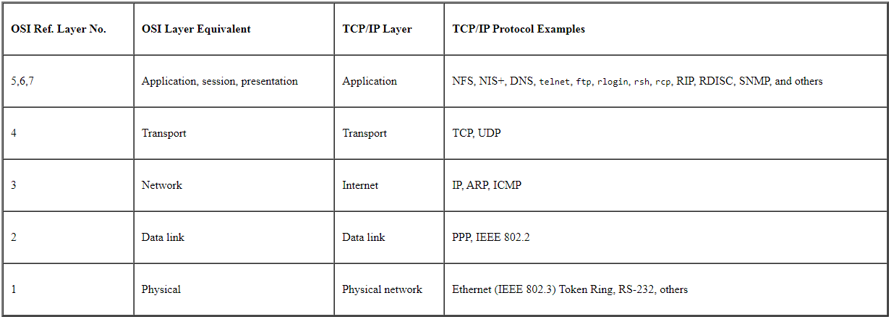
TCP/IP Protocol Stack

Slide 38
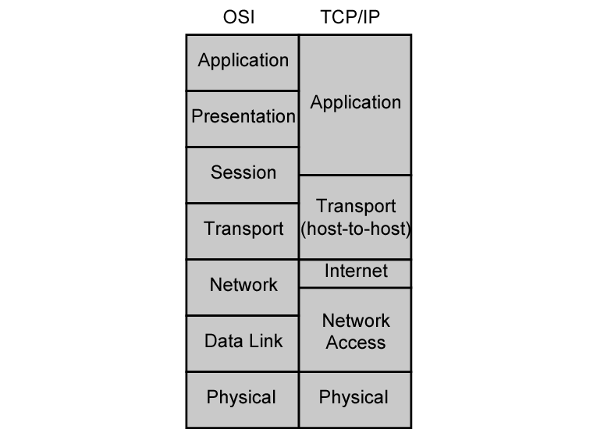
OSI v TCP/IP

Slide 39
Contd.
The application, Presentation and Session Layers of the OSI model are combined as the Application/Process Layer in TCP/IP protocol. It is the top layer of this protocol stack. This layer controls the user-interface and node-to-node communication. This layer provides the network interface, internetworking and transport functions. It sends the data to the transport layer.
The reliability, flow-control, and correction of data that is sent over the network are taken care of by the Transport Layer. User Datagram Protocol and the Transmission control protocol are present in the transport layer. After the transport layer, the control is given to the Internet layer.
The Internet Layer is also known as the network layer. Its function is to move the data packets over the internet to the destination. Data packets can take any of the optimized routes suggested by this layer. The most important protocol -IP Protocol is present in this layer. This protocol is responsible for adding the IP addresses to the data, routing the packets, data encapsulation, formatting.
The last layer in the TCP/IP protocol stack is the Network Access Layer. It is the combination of the physical and data link layers of the OSI model. The transmission of data physically over a network between two devices is controlled by this layer. The mapping of IP addresses of the devices into physical addresses is also done at this layer.

Slide 40
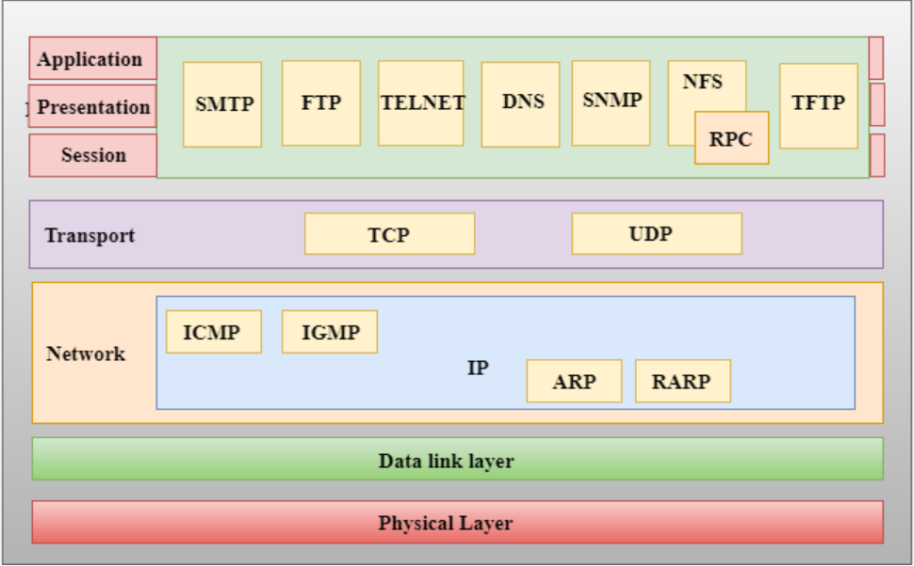
Functions of TCP/IP layers

Slide 41
Network Access Layer/Link Layer
A network layer is the lowest layer of the TCP/IP model.
A network layer is the combination of the Physical layer and Data Link layer defined in the OSI reference model.
It defines how the data should be sent physically through the network.
This layer is mainly responsible for the transmission of the data between two devices on the same network.
The functions carried out by this layer are encapsulating the IP datagram into frames transmitted by the network and mapping of IP addresses into physical addresses.
The protocols used by this layer are ethernet, token ring, FDDI, X.25, frame relay.

Slide 42
Internet Layer (IP)/Network Layaer
An internet layer is the second layer of the TCP/IP model.
An internet layer is also known as the network layer.
The main responsibility of the internet layer is to send the packets from any network, and they arrive at the destination irrespective of the route they take.
Following are the protocols used in this layer are:
  IP Protocol
  ARP Protocol
  ICMP Protocol

Slide 43
Contd.
IP Protocol
Following are the responsibilities of this protocol:
IP Addressing: This protocol implements logical host addresses known as IP addresses. The IP addresses are used by the internet and higher layers to identify the device and to provide internetwork routing.
Host-to-host communication: It determines the path through which the data is to be transmitted.
Data Encapsulation and Formatting: An IP protocol accepts the data from the transport layer protocol. An IP protocol ensures that the data is sent and received securely, it encapsulates the data into message known as IP datagram.
Fragmentation and Reassembly: The limit imposed on the size of the IP datagram by data link layer protocol is known as Maximum Transmission unit (MTU). If the size of IP datagram is greater than the MTU unit, then the IP protocol splits the datagram into smaller units so that they can travel over the local network. Fragmentation can be done by the sender or intermediate router. At the receiver side, all the fragments are reassembled to form an original message.
Routing: When IP datagram is sent over the same local network such as LAN, MAN, WAN, it is known as direct delivery. When source and destination are on the distant network, then the IP datagram is sent indirectly. This can be accomplished by routing the IP datagram through various devices such as routers.

Slide 44
Contd.
ARP Protocol
ARP stands for Address Resolution Protocol.
ARP is a network layer protocol which is used to find the physical address from the IP address.
The two terms are mainly associated with the ARP Protocol:
  ARP request: When a sender wants to know the physical address of the device, it broadcasts the ARP request to the network.
  ARP reply: Every device attached to the network will accept the ARP request and process the request, but only recipient recognize the IP address and sends back its physical address in the form of ARP reply. The recipient adds the physical address both to its cache memory and to the datagram header

Slide 45
Contd.
ICMP Protocol
ICMP stands for Internet Control Message Protocol.
It is a mechanism used by the hosts or routers to send notifications regarding datagram problems back to the sender.
A datagram travels from router-to-router until it reaches its destination. If a router is unable to route the data because of some unusual conditions such as disabled links, a device is on fire or network congestion, then the ICMP protocol is used to inform the sender that the datagram is undeliverable.
An ICMP protocol mainly uses two terms:
  ICMP Test: ICMP Test is used to test whether the destination is reachable or not.
  ICMP Reply: ICMP Reply is used to check whether the destination device is responding or not.
The core responsibility of the ICMP protocol is to report the problems, not correct them. The responsibility of the correction lies with the sender.
ICMP can send the messages only to the source, but not to the intermediate routers because the IP datagram carries the addresses of the source and destination but not of the router that it is passed to.

Slide 46
Transport Layer (TCP)
The transport layer is responsible for the reliability, flow control, and correction of data which is being sent over the network.
The two protocols used in the transport layer are User Datagram protocol (UDP) and Transmission control protocol (TCP).

Slide 47
Contd.
User Datagram Protocol (UDP)
  It provides connectionless service and end-to-end delivery of transmission.
  It is an unreliable protocol as it discovers the errors but not specify the error.
  User Datagram Protocol discovers the error, and ICMP protocol reports the error to the sender that user datagram has been damaged.
  UDP consists of the following fields:
  Source port address: The source port address is the address of the application program that has created the message.
  Destination port address: The destination port address is the address of the application program that receives the message.
  Total length: It defines the total number of bytes of the user datagram in bytes.
  Checksum: The checksum is a 16-bit field used in error detection.
  UDP does not specify which packet is lost. UDP contains only checksum; it does not contain any ID of a data segment.

Slide 48
Contd.
Transmission Control Protocol (TCP)
  It provides a full transport layer services to applications.
  It creates a virtual circuit between the sender and receiver, and it is active for the duration of the transmission.
  TCP is a reliable protocol as it detects the error and retransmits the damaged frames. Therefore, it ensures all the segments must be received and acknowledged before the transmission is considered to be completed and a virtual circuit is discarded.
  At the sending end, TCP divides the whole message into smaller units known as segment, and each segment contains a sequence number which is required for reordering the frames to form an original message.
  At the receiving end, TCP collects all the segments and reorders them based on sequence numbers.

Slide 49
Application Layer
An application layer is the topmost layer in the TCP/IP model.
It is responsible for handling high-level protocols, issues of representation.
This layer allows the user to interact with the application.
When one application layer protocol wants to communicate with another application layer, it forwards its data to the transport layer.
There is an ambiguity occurs in the application layer. Every application cannot be placed inside the application layer except those who interact with the communication system. For example: text editor cannot be considered in application layer while web browser using HTTP protocol to interact with the network where HTTP protocol is an application layer protocol.
The main protocols used in the application layer are,
  HTTP: HTTP stands for Hypertext transfer protocol. This protocol allows us to access the data over the world wide web. It transfers the data in the form of plain text, audio, video. It is known as a Hypertext transfer protocol as it has the efficiency to use in a hypertext environment where there are rapid jumps from one document to another.

Slide 50
Contd.
SNMP: SNMP stands for Simple Network Management Protocol. It is a framework used for managing the devices on the internet by using the TCP/IP protocol suite.
SMTP: SMTP stands for Simple mail transfer protocol. The TCP/IP protocol that supports the e-mail is known as a Simple mail transfer protocol. This protocol is used to send the data to another e-mail address.
DNS: DNS stands for Domain Name System. An IP address is used to identify the connection of a host to the internet uniquely. But, people prefer to use the names instead of addresses. Therefore, the system that maps the name to the address is known as Domain Name System.
TELNET: It is an abbreviation for Terminal Network. It establishes the connection between the local computer and remote computer in such a way that the local terminal appears to be a terminal at the remote system.
FTP: FTP stands for File Transfer Protocol. FTP is a standard internet protocol used for transmitting the files from one computer to another computer.

Slide 51
Difference between OSI & TCP/IP
OSI
TCP/IP
OSI refers to Open Systems Interconnection.
OSI has 7 layers.
OSI is less reliable.
In the OSI model, the transport layer is only connection-oriented, hence provides assurance delivery of packets.
OSI developed model then protocol.
Connection less and connection oriented both services are provided by network layer in OSI model.
In the OSI model, the data link layer and physical are separate layers.
OSI uses different session and presentation layers.
TCP refers to Transmission Control Protocol.
TCP/IP has 4 layers.
TCP/IP is more reliable.
The transport layer of the TCP/IP model is both connection-oriented and connectionless.
TCP/IP developed protocols then model.
TCP/IP model network layer only provides connection less services.
In TCP, physical and data link are both combined as a single host-to-network layer.
TCP/IP uses both session and presentation layer in the application layer itself.

Slide 52
Queries

